Slide 1
DDA Academy
team dda

Slide 2



THE TEAM MEMBERS:
ALEKSANDAR DIMITROV
DOBROMIR IVANOV
DELYAN NIKOLOV

Slide 3
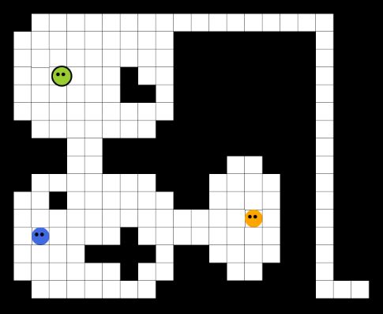
DDA ACADEMY EDUCATIONAL GAME
The problem ?
Learning is boring!
Solution:
Learn by play!

Slide 4
DDA ACADEMY EDUCATIONAL GAME
Market Target:
children in elementary and middle school
The main idea of the game:
The player explores fictional world and answers various questions as he encounters different npcs.
Extend the game:
character visual progress. Adding other RPG elements like – item collection – enemy fighting and other stuff.

